Slide 1


InceptionNet and ResNet
Goal: improve image recognition when deep CNNs become difficult to train
InceptionNet: better use of filters
ResNet: easier training of deep networks

Slide 2

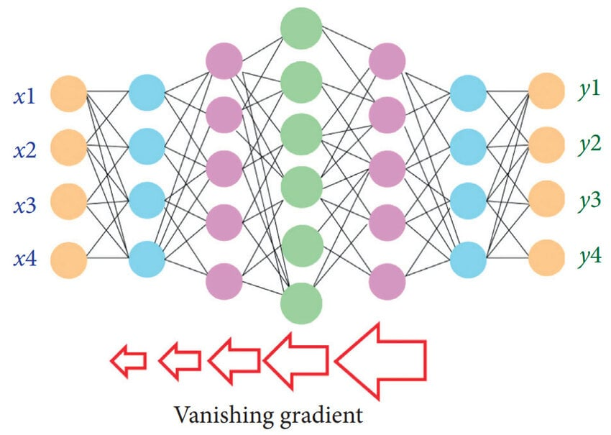
The Challenge of Deep CNNs
Limitations of traditional sequential architectures:
For 32 filters of a 5x5 convolution, and 256 channels input:
5 × 5 × 256 × 32 = 204 800 parameters
■
More layers = More learning capacity
BUT:
High computational cost: Many channels → many computation
■
■
Vanishing Gradient: The error signal becomes too weak when it is propagated to the first layers (during backpropagation). Last layers are well corrected but not the early ones

Slide 3
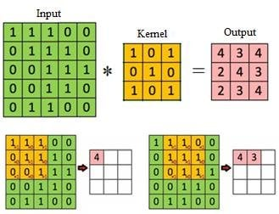
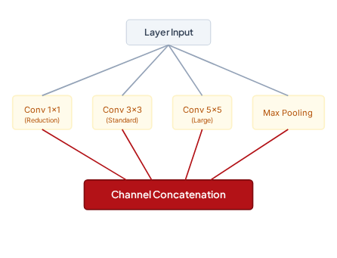
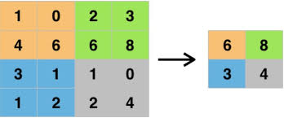
InceptionNet: Multi-Scale image processing
Without 1x1 reduction: 5 × 5 × 256 × 32 = 204 800 paramètres
With 1x1 reduction:
1×1 : 1 × 1 × 256 × 32 = 8 192 paramètres and then
5×5 : 5 × 5 × 32 × 32 = 25 600 paramètres
So a total of 33 792 parameters (way lower than before)
The Inception Module design:
→ First does a 1x1 convolution to reduce the number of parameters
■
Parallel Computations: Applies multiple kernel sizes simultaneously instead of picking just one.
■
1x1, 3x3, & 5x5 Kernels: Capture both local details and global structural elements in parallel.
■
Max Pooling: Extracts invariant spatial features to make translations robust.
■
Concatenation: Gathers different scale outputs along the channel axis.

Slide 4
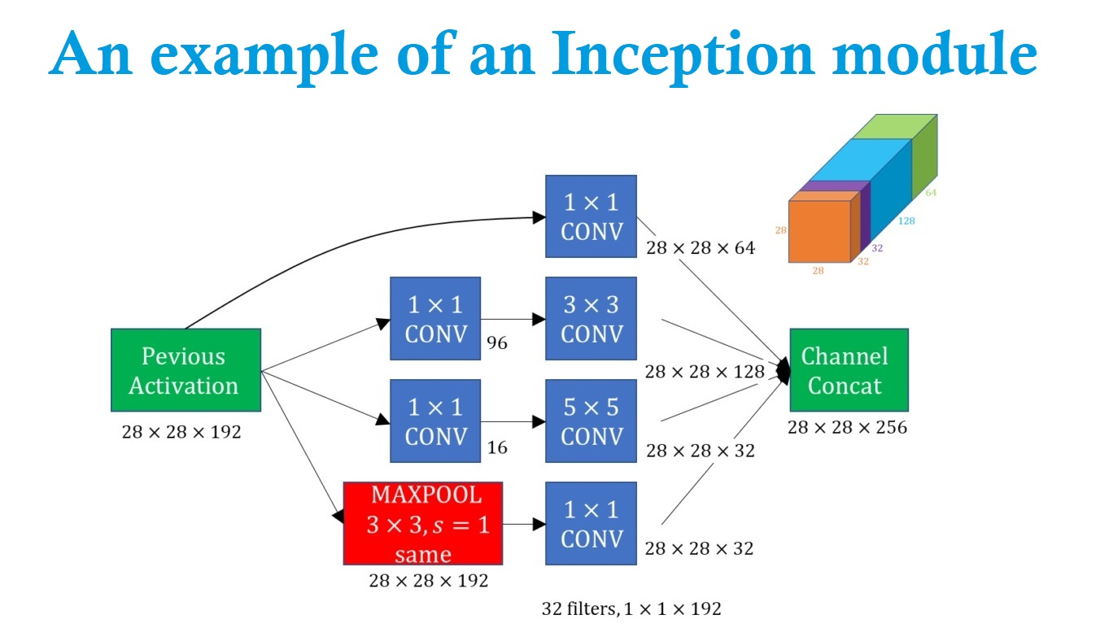

Cost Control with 1x1 Convolutions
How do we manage computational cost?
■
Dimensionality Reduction: 1x1 convolutions shrink the channel count before applying heavier spatial filters.
■
Concatenation: Concatenate the result after doing the multiple convolution operations to get multi-scale information efficiently

Slide 5
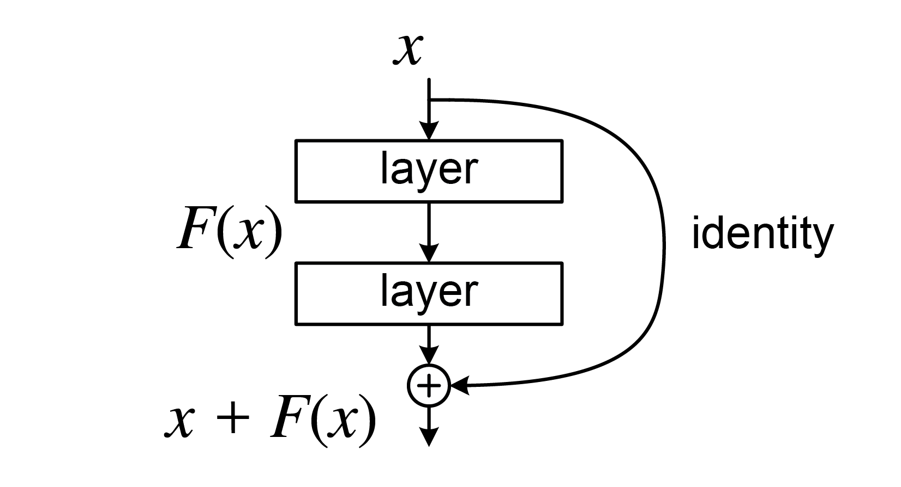
ResNet: Residual Connections
Skip Connection Mechanisms:
■
Classic Architecture: Standard networks attempt to learn the target mapping F(x) directly.
■
Residual Learning: Blocks learn a corrective residual function F(x), which is then added directly to input x.
■
Smooth Backpropagation: Gradients flow via the shortcut paths, preventing vanishing signals (that were caused by the n-multiplications of derivatives often <1)
→ Overall, skip connections in resnet allow an better gradient flow and we can build deeper networks

